Slide 1
IMSE 991 Multiple Criteria Decision Making
Lecture 4
Non-compensatory Methods

Slide 2
Homework #1
Discussion

Slide 3
Non-compensatory Methods
Non-compensatory Methods
Dominance Methods
Satisficing Methods
Sequential Elimination Methods
Attitude Oriented Methods
Compensatory Method Introduction
Team Project Presentation Discussion

Slide 4
Non-Compensatory Methods
The difference between non-compensatory methods and compensatory methods is whether the whether the advantages of one attribute can be traded for disadvantages of another
Compensatory method if trade-offs among attribute values are permitted
Otherwise it is non-compensatory

Slide 5
Non-Compensatory Methods
Dominance method
Satisficing Methods
Conjunctive Method
Disjunctive Method
Sequential Elimination Methods
Lexicographic Methods
Elimination by Aspects
Attitude Oriented Methods
Maximin
Maximax
Others…..

Slide 6
Dominance
An alternative is dominated if there is another alternative that excels it in one or more attributes and equals it in the remaining attributes
An alternative is non-dominated (called efficient frontier or Pareto Optimal) if there is no alterative that excels it in all the attributes considered

Slide 7
Dominance Method
Dominance method:
Eliminate all dominated alternatives
At least one attribute for an alternative surpasses the others
Could be more than one solutions generated by this method

Slide 8
Dominance Method
Eliminate Dominated Alternatives
Pairwise comparison between alternatives
Compare all attributes between the two alternatives and if one is dominated by the other, discard it
Compare the un-discarded alternatives with the next alternative and discard any dominated alternatives
Continue on until comparisons exhausted (m-1) comparison of m alternatives

Slide 9
Dominance Method
Dominance method
Example – Site Selection for a Textile Company
Sites | Community Attitude (X1) | Water Availability (X2) | Probability of Union (X3)
S1 | poor | good | 0.5
S2 | excellent | fair | 1.0
S3 | poor | poor | 1.0
S4 | fair | fair | 0.1
S5 | good | excellent | 0.2
S6 | fair | good | 0.9
S7 | good | fair | 1.0

Slide 10
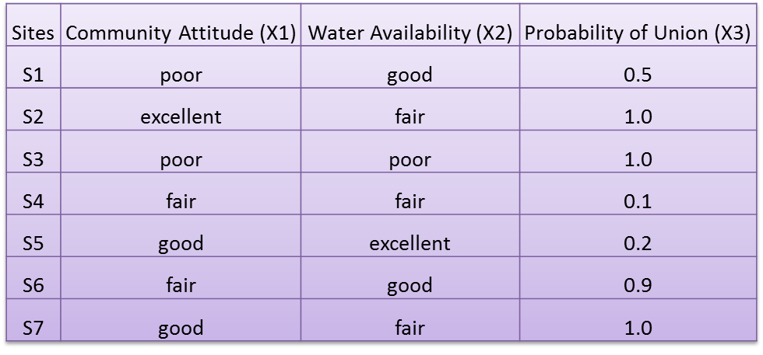
Dominance Method
Dominance method
S1 compared to S2: non-dominated
S1 compared to S3: S1 -> S3, S3 discarded
S4 compared to S1, S2: S1, S2, non-dominated
S5 compared to S1, S2, S4: S5 -> S1, S1 discarded
S6 compared to S2, S4, S5: S5 -> S6, S6 discarded
S7 compared to S2, S4, S5: S2 & S5 -> S7 discarded
S2, S4 and S5 are non-dominated solutions
Pick alternative OR use a compensatory method

Slide 11
Satisficing Methods
Satisficing Methods
Dichotomize alternatives into acceptable/ unacceptable categories
Alternatives are acceptable as long as they meet the minimum cutoffs
Satisficing rather than optimizing

Slide 12
Satisficing Methods
Satisficing Methods
Conjunctive method
Disjunctive Method

Slide 13
Satisficing Methods
Satisficing Methods
Conjunctive method
Set up minimum standard for each attribute
The alternative selection or evaluation process is to compare each attribute against its standard.
If the standard reflects the decision maker’s expectations, the obtained solutions are satisfying solutions.

Slide 14
Satisficing Methods
Satisficing Methods
Conjunctive method
An alternative must exceed a minimum value on all attributes
Alternatives are easily rejected
Need to fail on only one attribute
Decision maker supplies the minimal (cutoff) attribute values acceptable for each of the attributes
Minimal values can be adjusted, as per the decision maker, if too few or too many alternatives are remaining

Slide 15
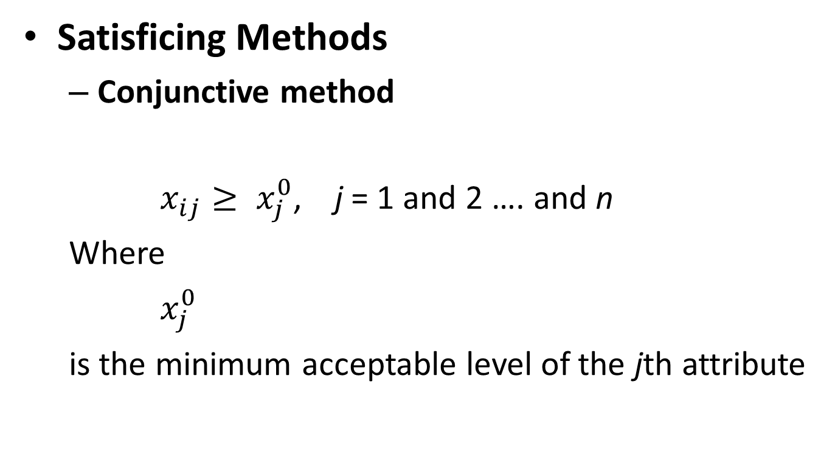
Satisficing Methods
Satisficing Methods
Conjunctive method
$x_{ij}≥ x_{j}^{0}$, j = 1 and 2 …. and n
Where
$x_{j}^{0}$
is the minimum acceptable level of the jth attribute

Slide 16
Satisficing Methods
Satisficing Methods
Conjunctive method
Minimum standards for admissions are set
All attributes for an alternative are compared to the minimum standards
Students A1 and A3 are rejected
Students | TOEFL | GRE | GPA
A1 | 582 | 1420 | 2.8
A2 | 563 | 1250 | 3.5
A3 | 620 | 1080 | 3.2
A4 | 558 | 1280 | 3.0
Minimum | 550 | 1200 | 3.0

Slide 17
Satisficing Methods
Satisficing Methods
Conjunctive method
Not usually used for selection of alternatives but for dichotomizing them into acceptable/ not acceptable categories
One way to set up the standards if the DM wants to dichotomize the alternatives

Slide 18
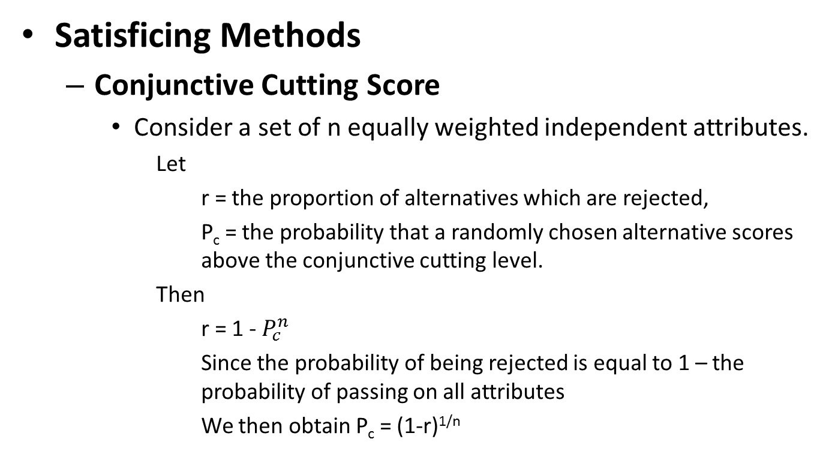
Satisficing Methods
Satisficing Methods
Conjunctive Cutting Score
Consider a set of n equally weighted independent attributes.
Let
r = the proportion of alternatives which are rejected,
P_{c} = the probability that a randomly chosen alternative scores above the conjunctive cutting level.
Then
r = 1 - $P_{c}^{n}$
Since the probability of being rejected is equal to 1 – the probability of passing on all attributes
We then obtain P_{c} = (1-r)^{1/n}

Slide 19
Satisficing Methods
Satisficing Methods
Conjunctive Cutting Score
Example:
Four attributes for college admissions – intellectual ability, academic ability, extracurricular activities, character
Attributes are independent and equally important
College wishes to accept one fifth of its applicants
n = 4, r = 4/5
P_{c} = (1-4/5)^{1/4} = 0.67 = 67%

Slide 20
Satisficing Methods
Satisficing Methods
Conjunctive Cutting Score
Example (cont):
The college must choose a cutting score for each attribute such that 67% of its applicants will place above this score
The cutting score is called the conjunctive cutting score
Note: This method can be used with both objective and subjective data

Slide 21
Satisficing Methods
Satisficing Methods
Conjunctive cutting score
Accept 1/4th of students
R = ¾
N = 3
P_{c} = (1-r)^{1/n}
P_{c} = (1-3/4)^{1/3}
P_{c} = 63% place above score on each attribute
Small data set with only 4 observations each – round up to 75%
Student | TOEFL | GRE | GPA
A1 | 582 | 1420 | 2.8
A2 | 563 | 1250 | 3.5
A3 | 620 | 1080 | 3.2
A4 | 558 | 1280 | 3.0
Minimum | 564 | 1081 | 2.9

Slide 22
Satisficing Methods
Satisficing Methods
Disjunctive method
This method evaluates an alternative on its best attribute regardless of all other attributes.
The decision maker must establish cutoff values for the attributes
An alternative is chosen if and only if it exceeds a minimal cutoff on one or more attributes

Slide 23
Satisficing Methods
Satisficing Methods
Disjunctive method
Minimal cutoffs can be varied if too many or two few alternatives are selected
Can be used in conjunction with the conjunctive method

Slide 24
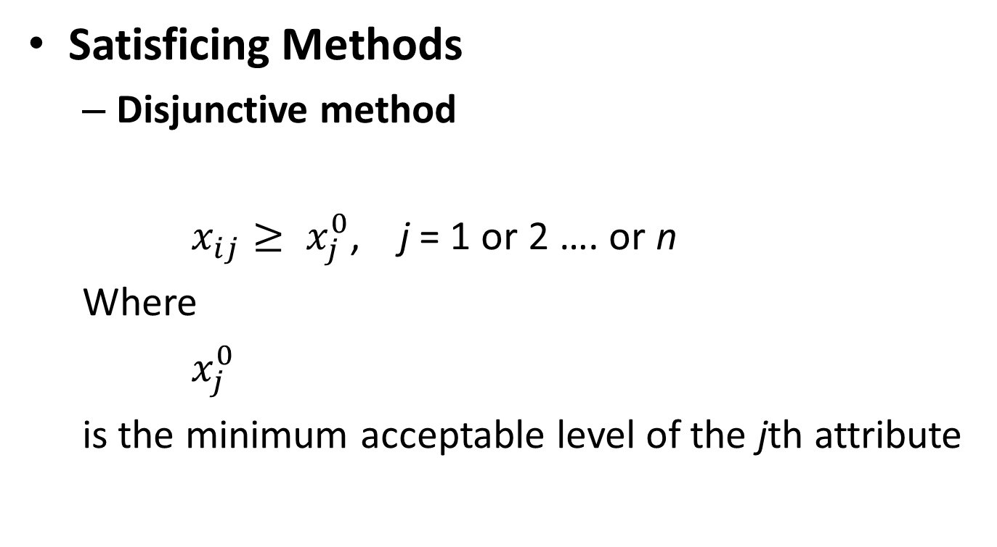
Satisficing Methods
Satisficing Methods
Disjunctive method
$x_{ij}≥ x_{j}^{0}$, j = 1 or 2 …. or n
Where
$x_{j}^{0}$
is the minimum acceptable level of the jth attribute

Slide 25
Satisficing Methods
Satisficing Methods
Disjunctive method
Note: Different answer than conjunctive method
All students meet at least one of the minimums
Students | TOEFL | GRE | GPA
A1 | 582 | 1420 | 2.8
A2 | 563 | 1250 | 3.5
A3 | 620 | 1080 | 3.2
A4 | 558 | 1280 | 3.0
Minimum | 550 | 1200 | 3.0

Slide 26
Satisficing Methods
Satisficing Methods
Disjunctive Cutting Score
For the disjunctive method, the probability of being rejected is equal to the probability of failing on all attributes:
r = (1 – P_{d})^{n}
Where r is the proportion of alternatives which are rejected, and P_{d} is the probability that a randomly chosen alternative scores above the disjunctive cutting level. Therefore,
P_{d} = 1 – r^{1/n}

Slide 27
Satisficing Methods
Satisficing Methods
Disjunctive Cutting Score
Example:
Four attributes for college admissions – intellectual ability, academic ability, extracurricular activities, character
Attributes are independent and equally important
College wishes to accept one fifth of its applicants
n = 4, r = 4/5
P_{d} = 1 – (4/5)^{1/4} = 0.05 = 5%
The disjunctive cutting score for each attribute will be one such that 5% of the applicants score above it – contrasted to 67% for the conjunctive cutting score

Slide 28
Sequential Elimination Methods
Sequential Elimination Methods
Eliminates alternatives in a sequential manner
Use one attribute at a time to examine alternatives for elimination
If more than one alternative remains after the first pass, the process is repeated using another attribute
Methods
Lexicographic methods – Examines alternatives in the order of attribute importance
Elimination by Aspects – In the order that would eliminate the most alternatives

Slide 29
Sequential Elimination Methods
Lexicographic Method
Sometimes, a single attribute is the most important attribute for a decision, “cheapest,” “highest quality,” “highest profit,” etc.
Compare alternatives on the most important attribute
Choose the alternative with the highest value for the preferred attribute
If there is a tie, compare the next highest attribute
Lexicography – reflects concept of words ordered in a dictionary

Slide 30
Sequential Elimination Methods
Lexicographic Method
Let x₁ be the most important attribute to the DM, x₂, the second most important one, etc. Alternative A¹ is selected such that
If the set A¹ has a single element, then this element is the most preferred alternative.
If there is a tie, continue the assessment with the remaining attributes
$$A^{1}=\left\{A_{i} | \max{x_{i1}}\right\} i=1, 2, …, m$$

Slide 31
Sequential Elimination Methods
Lexicographic Method
Selection based on Total Medals
Second level attribute was Gold Medals
Rank | Country | Gold Medals | Silver Medals | Bronze Medals | Total Medals
1 | Unified Team | 45 | 38 | 29 | 112
2 | United States | 37 | 34 | 37 | 108
3 | Germany | 33 | 21 | 28 | 82
4 | China | 16 | 22 | 16 | 54
5 | Cuba | 14 | 6 | 11 | 31
6 | Hungary | 11 | 12 | 7 | 30
7 | South Korea | 12 | 5 | 12 | 29
8 | France | 8 | 5 | 16 | 29
9 | Australia | 7 | 9 | 11 | 27
10 | Spain | 13 | 7 | 2 | 22
Note tie between South Korea and France and use of Gold Medals to break tie

Slide 32
Sequential Elimination Methods
Elimination by Aspects
Similar to the Lexicographic method
Examines one attribute at a time, making comparisons among alternatives
Differs slightly because it eliminates alternatives that do not satisfy some standard
Continues until all alternatives except one have been eliminated
Attributes are not ordered in terms of their importance but in terms of the probabilistic discrimination power – likelihood for more alternatives to fail

Slide 33
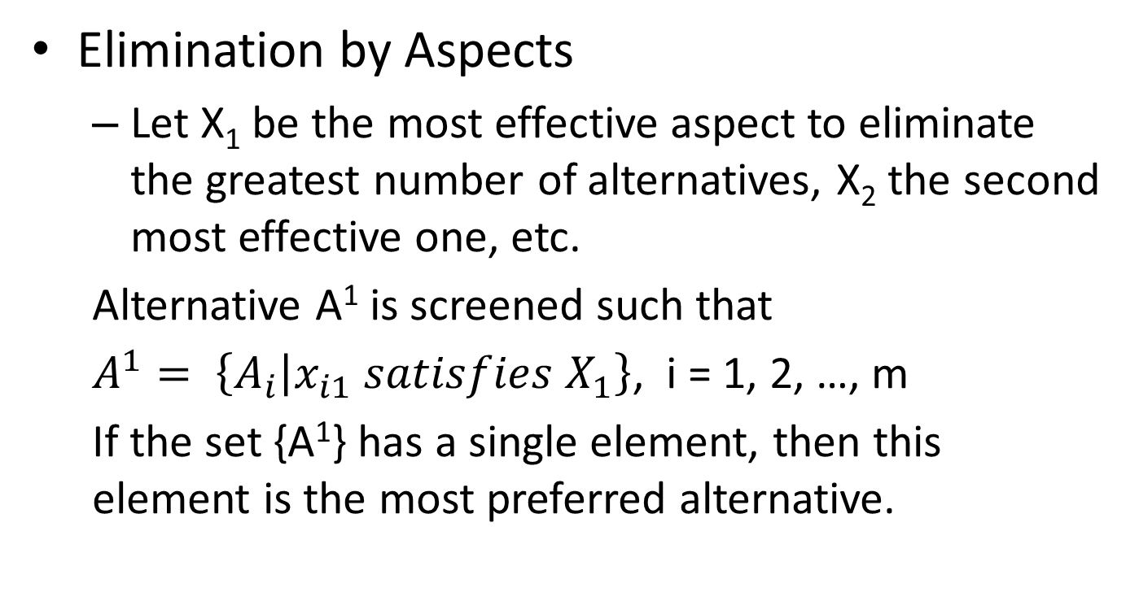
Sequential Elimination Methods
Elimination by Aspects
Let X₁ be the most effective aspect to eliminate the greatest number of alternatives, X₂ the second most effective one, etc.
Alternative A¹ is screened such that
$A^{1}= \left\{A_{i} | x_{i1} satisfies X_{1}\right\}$, i = 1, 2, …, m
If the set {A¹} has a single element, then this element is the most preferred alternative.

Slide 34
Sequential Elimination Methods
Elimination by Aspects
Long distance phone company selection
Eliminate alternatives on the basis of the aspects most likely to eliminate alternatives.
Companies | Service | Credits | Global | Connection | Discounts
A1 | Y | Y | N | Y | Y
A2 | N | Y | N | Y | Y
A3 | Y | Y | Y | Y | Y
A4 | Y | N | N | Y | Y
Order of Aspect | Remaining Alternatives
Discounts | A1 | A2 | A3 | A4
Credits | A1 | A2 | A3 | A4
Service | A1 | A2 | A3
Global | A1 |  | A3
A3 is the selected long distance phone company.

Slide 35
Attitude Oriented Methods
Attitude Oriented Methods
Maxmin method
Find the weakest attribute value (min) of each alternative and then choose the alternative with the best (max) weakest attribute value.
Maxmax Method
In contrast to the Maxmin method, the Maxmax method selects an alternative by its best attribute value.
Hurwicz Criterion
Hurwicz rule allow for a degree of optimism and pessimism

Slide 36
Attitude Oriented Methods
Attitude Oriented Methods
Maxmin method:
Find the weakest attribute value (min) of each alternative and then choose the alternative with the best (max) weakest attribute value.
The logic is that a chain is as strong as its weakest link.
This method is applicable only when attribute values are comparable with one another, either measured in the same unit or transformed to a common scale.

Slide 37
Attitude Oriented Methods
Attitude Oriented Methods
Maxmax Method:
In contrast to the Maxmin method, the Maxmax method selects an alternative by its best attribute value.
It is also applicable only when attributes are comparable.

Slide 38
Attitude Oriented Methods
Attitude Oriented Methods
Example

Slide 39
Attitude Oriented Methods
Attitude Oriented Methods
Maximin and Maximax Criteria
Maximin – pessimistic, worst case scenario
Max {min r_{ij}}
^{i j}
Maximax – optimistic case, best case scenario
Max {max r_{ij}}
^{i j}
39
Notes:
39

Slide 40
Attitude Oriented Methods
Attitude Oriented Methods
Example
Maximin = A1 and A4 are selected
Maximax = A2 are selected

Slide 41
Attitude Oriented Methods
Hurwicz Criterion
Hurwicz rule allow for a degree of optimism and pessimism
Decision maker selects an index of optimism, α, such that 0 ≤ α ≤ 1.0. When α = 0, the decision maker is pessimistic, when α = 1.0, the decision maker is optimistic
The rule is stated where E_{ij} is the payoff for the ith alternative and the jth attribute
Max {α [max E_{ij}] + (1 – α) [min E_{ij}]}
i j j
41
Notes:
41

Slide 42
Attitude Oriented Methods
Hurwicz Criterion
When α = 0, it is the same as the maximin rule
Max {0 [max E_{ij}] + (1 – 0) [min E_{ij}]} = Max {min E_{ij}}
i j j i j
When α = 1, it is the same as the maximax rule
Max {1 [max E_{ij}] + (1 – 1) [min E_{ij}]} = Max {max E_{ij}}
i j j i j
42
Notes:
42

Slide 43
Attitude Oriented Methods
Hurwicz Criterion – Graph of example
$600
$400
$200
0
$-200
$600
$400
$200
0
$-200
A₂
A₃
A₁
A₄
0.2 0.4 0.6 0.8
α
43
Notes:
43

Slide 44
Compensatory Method Introduction
Compensatory Methods
Compensatory methods permit tradeoffs between attributes.
A slight decline in one attribute is acceptable if it is compensated by some enhancement in one or more other attributes.
We will cover a number of compensatory methods in this class. These methods fall into four categories.

Slide 45
Compensatory Method Introduction
Compensatory Methods
Compensatory methods can be classified into the following 4 subgroups.
Scoring Methods
Compromising Methods
Concordance Methods
Evidential Reasoning Methods

Slide 46
Compensatory Method Introduction
Compensatory Methods
Scoring Methods
The scoring method selects or evaluates an alternative according to its score (or utility).
Utility or score is used to express the decision maker’s preference. It transforms attribute values into a common preference scale such as [0,1] so that comparisons between different attributes becomes possible.

Slide 47
Compensatory Method Introduction
Compensatory Methods
Scoring Methods
A very popular method in this category is the Simple Additive Weighting method. This method calculates the overall score of an alternative as the weighted sum of the attribute scores or utilities.

Slide 48
Compensatory Method Introduction
Compensatory Methods
Scoring Methods
The Analytical Hierarchy Process (AHP) is another popular method in this category. This method calculates the scores for each alternative based on pairwise comparisons [Saaty, 1988.].
Multiple Attribute Utitlity Theory is another method in this category that develops utility curves for preference

Slide 49
Compensatory Method Introduction
Compensatory Methods
Compromising Methods
The compromising method selects an alternative that is closest to the ideal solution.
The Technique for Order Preference by Similarity to Ideal Solution (TOPSIS) method belongs to this category.

Slide 50
Compensatory Method Introduction
Compensatory Methods
Compromising Methods
The Technique for Order Preference by Similarity to Ideal Solution (TOPSIS) method belongs to this category.
This method first normalizes the decision matrix of a MCDM problem.
Based on the normalized decision matrix, it calculates the weighted distances of each alternative from an ideal solution and a negative ideal solution.
A solution relatively close to the ideal solution and far from the negative ideal solution is evaluated to be the best [Hwang and Yoon, 1981].

Slide 51
Compensatory Method Introduction
Compensatory Methods
Concordance Methods
The concordance method generates a preference ranking which best satisfies a given concordance measure.
The Linear Assignment Method is one of the examples in this family.
In this method it is believed that an alternative having many highly ranked attributes should be ranked high.

Slide 52
Compensatory Method Introduction
Compensatory Methods
Evidential Reasoning Approach
The evidential Reasoning (ER) approach has been recently developed in the MCDM area.
It is different from the above 3 conventional methods. Instead of describing a MCDM problem with a decision matrix, the ER approach uses a extended decision matrix, in which each attribute of an alternative is described by a distributed assessment using a belief structure.

Slide 53
Compensatory Methods
Compensatory Methods
Evidential Reasoning Approach
For example, the distributed assessment result of the quality of a car engine could be {(Excellent, 60%), (Good, 40%), (Average, 0%), (Poor, 0%), (Worst, 0%)}, which means the quality of the car engine is assessed to be Excellent with 60% of belief degree and Good with 40% of belief degree.

Slide 54
Team Project Presentation #1
Suggested Agenda
Selecting a representative organization
Providing an understanding of the operating environment
Developing corporate goals, decision criteria and metrics
Developing an importance weighting for the objectives and decision criteria

Slide 55
Team Project Presentation #1
Note
The goals, decision criteria and metrics that you develop for your project will be those that we ultimately rank alternatives with MCDM methods.
This is different than developing operating metrics, although there may be some cross-over between the two
This approach established a decision framework for alternatives such as products and projects we may select in the decision process.

Slide 56
Team Project Presentation #1
Selecting a representative organization
Describe the organization
Your company (no proprietary information)
A company of interest
A company you’d like to start
Discuss its products, distribution and operating characteristics
Discuss why you selected the organization

Slide 57
Team Project Presentation #1
Providing an understanding of the operating environment
What are its sales?
What are the product lines?
How many employees?
Is it a high tech/low tech company?
How many plants or distribution centers does it have?

Slide 58
Team Project Presentation #1
Developing corporate goals, decision criteria and metrics
Use the steps in the previous lectures to develop corporate goals, decision criteria and metrics
Review SEC filings, business information, and/or develop your own goals, decision criteria and metrics
The resulting set of goals and decision criteria may be a hierarchy.

Slide 59
Team Project Presentation #1
Developing an importance weighting for the objectives and decision criteria
Develop weightings for the objectives and decision criteria
Describe group decision making techniques to support the process
Provide insights from the development process and weightings

Slide 60
Team Project Presentation #1
Keep the presentation to 15 minutes
Provide professional slides
Do not use an excessive number of slides
Would like to have all students present throughout the course, if possible
Present as though you are presenting to an executive….great skill to learn and practice

Slide 61
IMSE 991 Multiple Criteria Decision Making
Lecture 4
Non-compensatory Methods

